Slide 1
VARDHAMAN COLLEGE OF ENGINEERING DEPARTMENT OF COMPUTER SCIENCE AND ENGINEERING
Mini Project Review - I
Title: Bike Crash Detection Using Machine Learning
Team No: 23MPCS-G8
Guide Details
Namani Deepika Rani
Assistant Professor
S.No | Roll No | Student Name
1 | 23881A05EH | T.Sri Lakshmi
2 | 23881A05DS | N.Rishitha
3 | 23881A05ED | E.Sai Nipun Reddy

Slide 2
Table of Contents
1. Title
2. Introduction
3. Background Research
4. Architecture
5.Project planning
6. Literature Survey
7. Implementation
8. Flowchart
9. Objectives
10. Project Milestone Tracker
11. Results

Slide 3
TITLE
Project Title:Bike Crash Detection Using Machine Learning.
Domain/Area: Machine Learning
Type: Application( Intelligent Safety System)
Keywords:Random Forest Tree
SVM
Neural Networks

Slide 4
INTRODUCTION
Road traffic injuries are also one of the primary reasons for death in the world, especially in developing countries, where two-wheelers are recognized as the primary mode of transport.
Physical safety for riders is a very minimal advantage of using motorcycles compared to four-wheeled vehicles, and hence the need for accident response and rapid delivery of first aid.
Among the most important factors related to the regulation of accidents, the issue of delayed reporting should be mentioned.
Awareness and severe injuries hinder victims in many cases to make calls for assistance.
Automatic systems of crash detection can significantly reduce the time of response and improve the survival rate.

Slide 5
BACKGROUND RESEARCH
Bike accidents often go unreported quickly, leading to delayed medical help.
Traditional crash detection uses fixed thresholds, but these methods are inaccurate because normal bumps and sudden braking can look like accidents.
With the availability of sensors like accelerometers, gyroscopes, and GPS, researchers started using machine learning to analyze sensor patterns and accurately detect real crashes.
ML-based systems can identify accidents more reliably and send automatic alerts to emergency services, helping reduce response time and save lives.

Slide 6
BACKGROUND RESEARCH – Challenges
Delayed accident reporting
High false alarms in threshold-based systems
Lack of real-time intelligence
Limited accuracy in complex crash scenarios

Slide 7
BACKGROUND RESEARCH – Motivation
Rising number of bike accidents
Need for automatic emergency response
Advances in machine learning & sensors
Improving rider safety & reducing response time

Slide 8
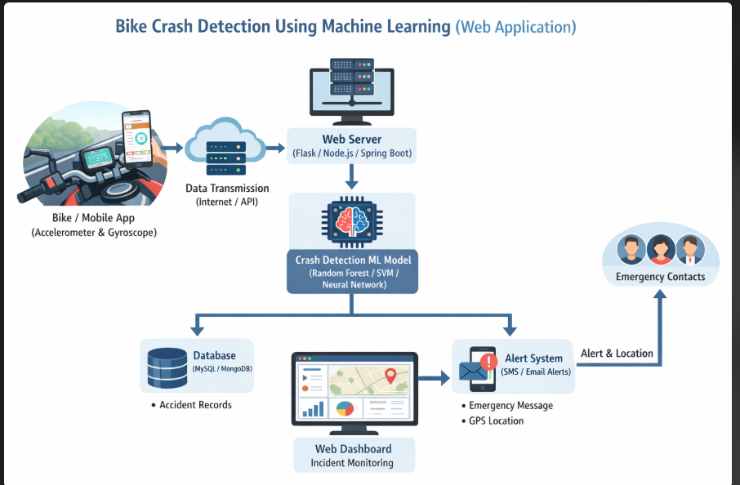
ARCHITECTURE

Slide 9
PROJECT PLANNING
Phase 1 — Problem Understanding & Literature Review
Study existing bike crash detection methods, identify limitations, define project scope, and review related research.
Phase 2 — Data Collection & Preparation
Collect sensor data (accelerometer, gyroscope); preprocess, clean, and label crash and non-crash events.
Phase 3 — Model Training & Development
Extract features and train machine-learning models; tune parameters and validate detection results.

Slide 10
Phase 4 — Evaluation & Optimization
Evaluate performance using accuracy, precision, recall, and F1-score; optimize to reduce false alarms.
Phase 5 — Deployment / Demonstration
Integrate the model into a prototype system with real-time crash detection and emergency alerts.
Phase 6 — Report / Presentation Preparation
Document results, compare with existing work, and outline future improvements.

Slide 11
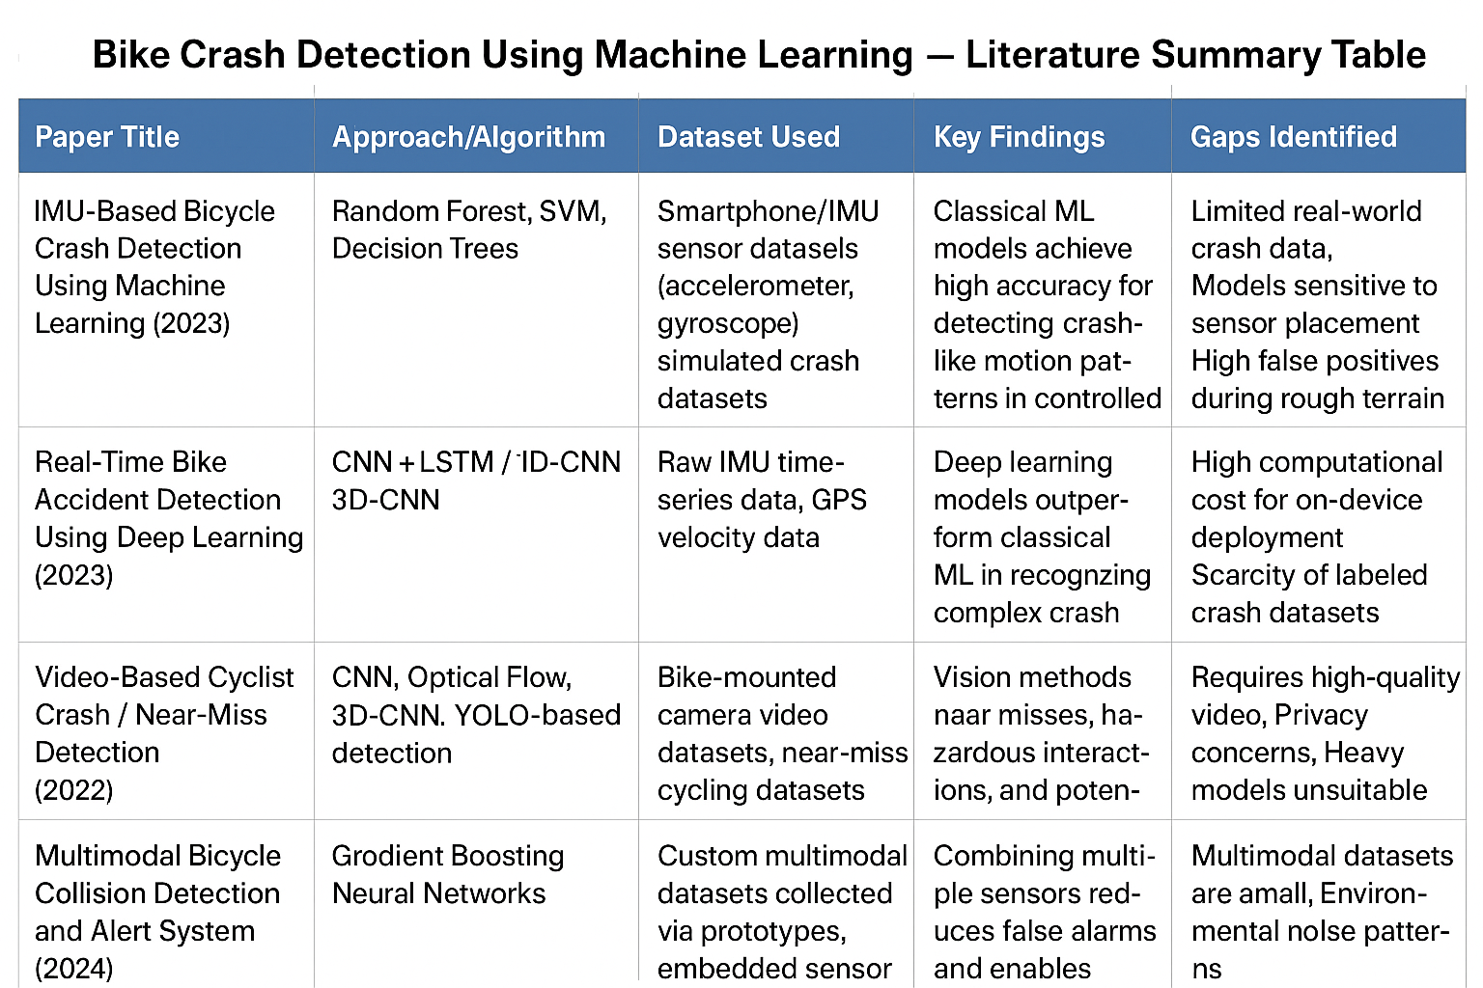
LITERATURE SURVEY

Slide 12
IMPLEMENTATION
Based on a deep learning approach, our Bike Crash Detection System implementation employs a hybrid Convolutional Neural Network (CNN) and Long Short-Term Memory (LSTM) network to detect crash and non-crash situations based on sensor data. The
system was developed using the Python programming language and the TensorFlow/Keras deep learning library.
The system as a whole combines real-time sensor data acquisition, preprocessing modules, model prediction, and emergency notification generation.

Slide 13
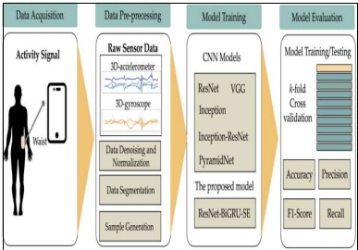
IMPLEMENTATION

Slide 14
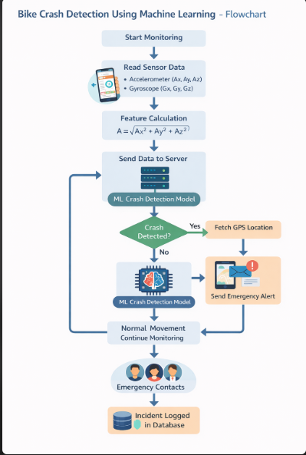
FLOW CHART

Slide 15
OBJECTIVES
1.To develop a machine learning model that accurately detects bike crashes using sensor data use accelerometer, gyroscope, and other IMU readings to identify sudden impact or abnormal movement patterns.
2. To collect and analyze sensor data for both normal rides and crash-like events Build a dataset that helps differentiate between routine bike movements and actual accidents.
3. To reduce false alarms by applying advanced ML/DL techniques Improve reliability compared to simple threshold-based systems that confuse bumps or sudden braking as crashes.
.

Slide 16
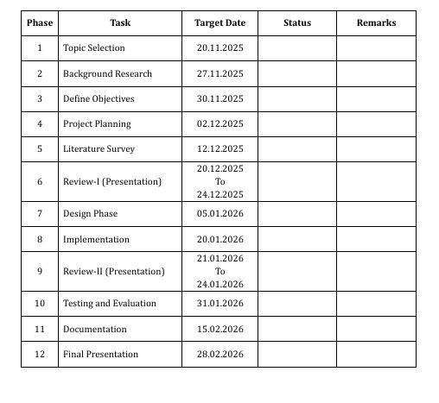
PROJECT MILESTONE TRACKER

Slide 17
RESULTS
The system successfully collects accelerometer and gyroscope data from the mobile device.
1.Sensor data is continuously monitored in real time while the bike is moving.
2.The system calculates total acceleration magnitude to identify abnormal impacts.
3.The machine learning model analyzes sensor patterns to detect possible crashes.
4. When the acceleration exceeds the defined crash threshold, the system identifies it as a crash event.

